Slide 1

Predicting nba player salaries

Slide 2
When determining a player’s potential salary we should look at the following metrics in regards to position.
The five positions studied and the metrics affecting the salary at these positions are:
Point Guard: Points > Minutes Played > Win Share > Turnovers > Assists
Shooting Guard: Points > PER > Assists > Win Share > Usage Rate
Small Forward: Points > PER > Win Share > Assists > Turnovers
Power Forward: Points > Assists > Minutes Played > Win Shares > Rebounds
Center: Minutes Played > Points > Win Share > Assists > Rebounds

Slide 3
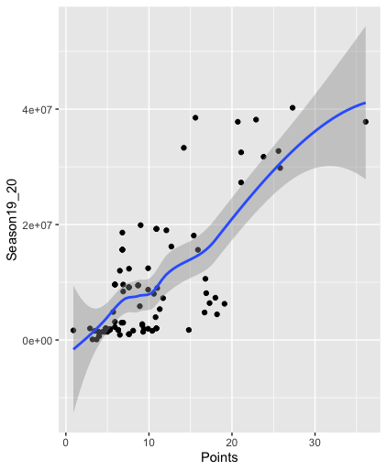
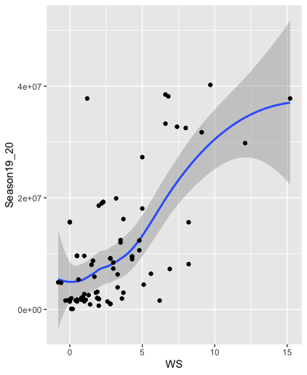
Point Guard Analysis
The factors that influenced a point guards salary were points, minutes played, win shares, turnovers and assists.
Adjusted R² Value: 0.71
P Value: 5.014 x 10⁻¹²

Slide 4
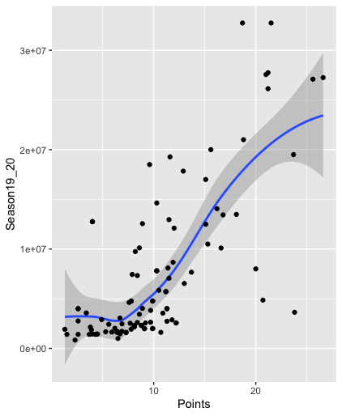
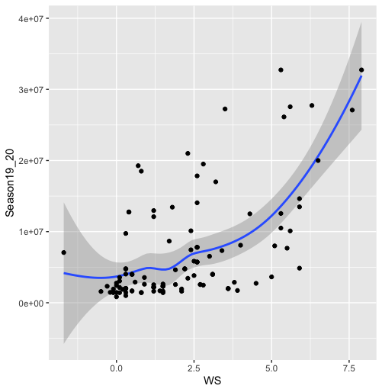
Shooting Guard Analysis
The factors that influence shooting guard salary are points, PER, assists, Win Share, and Usage Rate
Adjusted R² Value: 0.66
P Value: 1.704 x 10⁻¹⁴

Slide 5
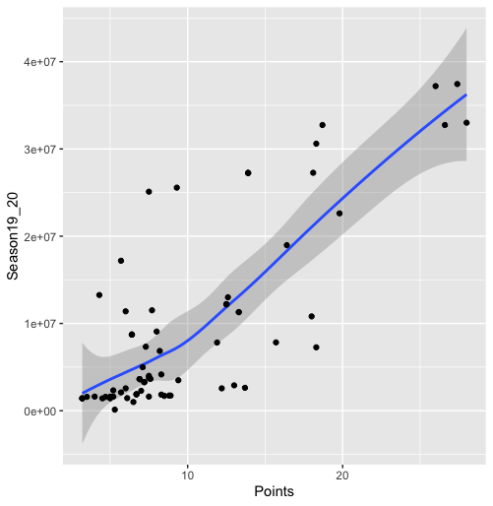
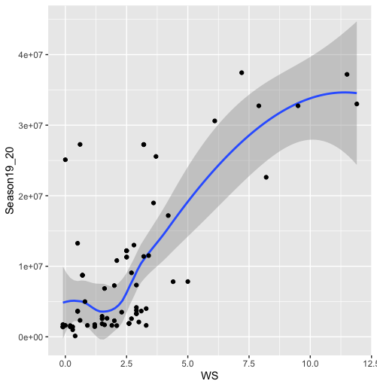
Small Forward Analysis
The order of correlated variables was points, PER, Win Share, Assists, Turnovers
Adjusted R² Value: 0.806
P Value: 7.079 x 10⁻¹²

Slide 6
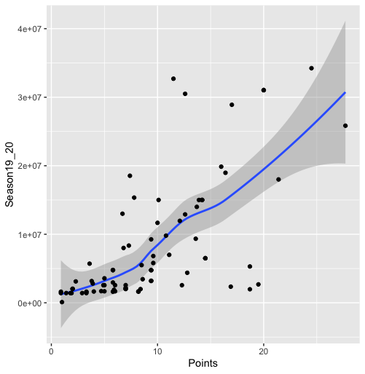
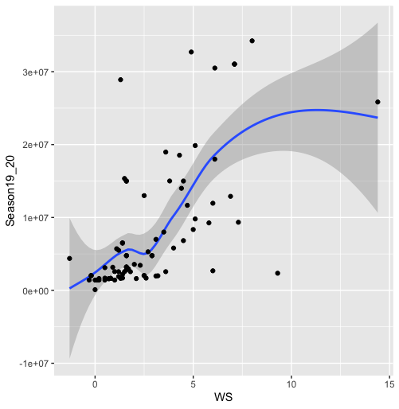
Power Forward Analysis
The factors that influence power forward salary are points, assists, minutes played, win shares and rebounds.
Adjusted R² Value: 0.7192
P Value: 8.863 x 10⁻¹²

Slide 7
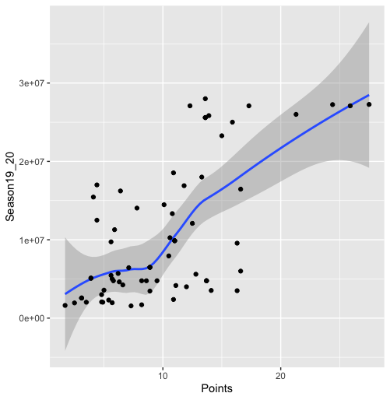
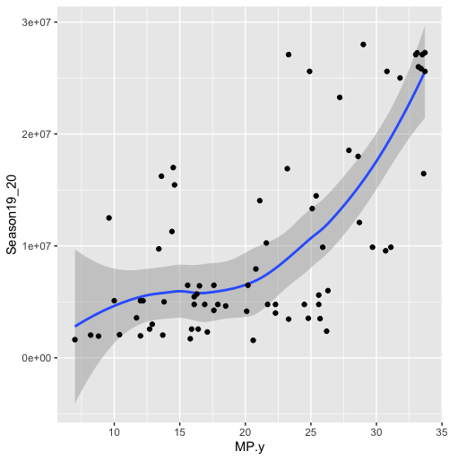
Center Analysis
The factors that influence center salary are minutes played, points, win share, assists and rebounds.
Adjusted R² Value: 0.5321
P Value: 1.052 x 10⁻¹⁰

